Slide 1
Unit I: Fundamentals of Marketing
Fundamentals of Marketing – Role of Marketing – Relationship of Marketing With Other Functional Areas- Concept of Marketing Mix – Marketing Approaches – Various Environmental Factors Affecting the Marketing Functions.

Slide 2

Fundamentals of Marketing

Slide 3
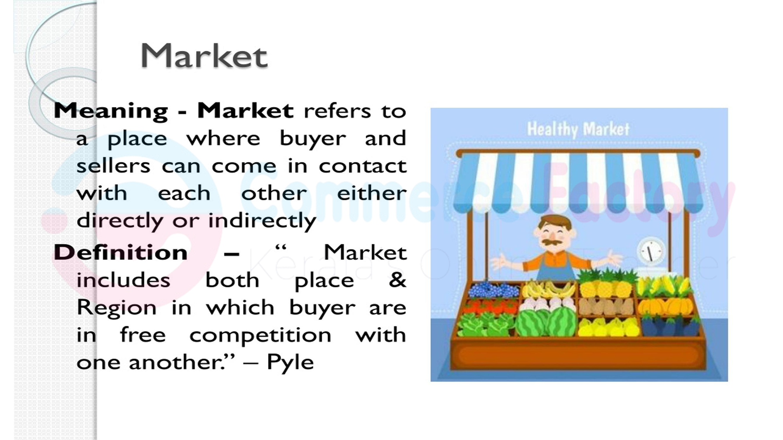

Slide 4
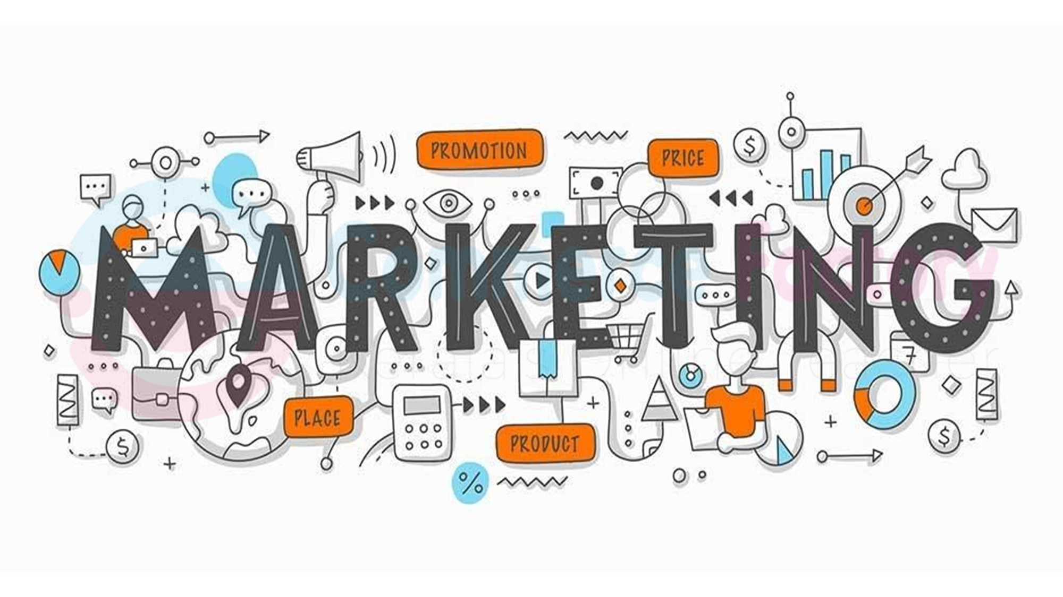

Slide 5
Meaning of Marketing:
Marketing refers to the activities involved in identifying customer needs and fulfilling them in the best possible way.
It includes everything from understanding what people want, producing the product, deciding the price, promoting it, and delivering it.
The main aim of marketing is to satisfy customer needs and earn profit.

Slide 6
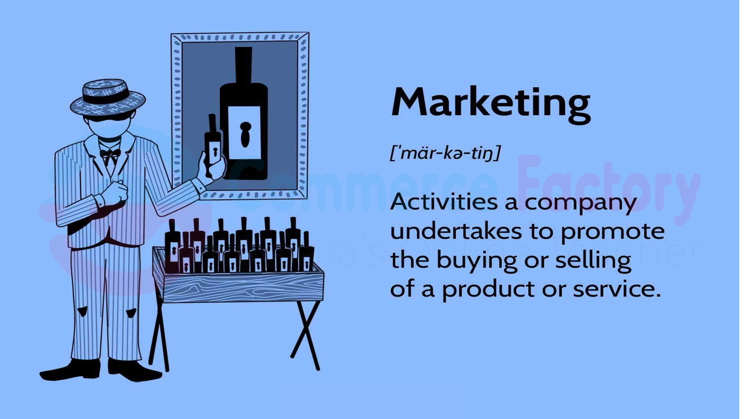

Slide 7
Definition of Marketing:
• Philip Kotler: "Marketing is the science and art of exploring, creating, and delivering value to satisfy the needs of a target market at a profit."
• In simple words, marketing means finding out what customers want, making it available, and ensuring they are happy with it.

Slide 8
Nature of Marketing:
Focus is on the customer’s needs and satisfaction.
Aims at earning profit by creating value for customers.
Keeps changing as per market trends, competition and technology.
Helps in improving the standard of living and creating employment.
Involves exchange of goods/services for money or value.

Slide 9
Scope of Marketing:
Marketing covers a wide range of activities:
Understanding customer behaviour, tastes, and preferences.
Designing and improving products as per need.
Deciding the right price that is affordable and profitable.
Informing and persuading customers through advertising, sales, etc.
Making products available to customers at the right place and time.
Providing support to customers even after the sale.

Slide 10
Importance of Marketing
Marketing helps a business understand customer needs.
Example: A mobile company learns that students want better cameras.
It increases sales by attracting more buyers.
Example: A bakery sells more cakes after advertising its offers.
Marketing creates brand awareness among customers.
Example: Amul ads help people easily recognize the brand.
It builds customer loyalty through good service and offers.
Example: Amazon Prime keeps customers loyal with fast delivery.
Marketing helps a company face competition.
Example: Domino’s attracts customers with its 30-minute delivery promise.

Slide 11
6. It helps introduce new products successfully.
Example: Oreo promotes its new flavors on social media to attract buyers.
7. Marketing improves the public image of a company.
Example: TATA supports social causes, building a positive brand image.
8. It guides production by showing what customers prefer.
Example: Laptop makers increase production of lightweight models.
9. Marketing supports business expansion into new markets.
Example: Indian brands promote their products in Gulf countries.
10. It supports the economy by creating jobs and promoting trade.
Example: Advertising agencies employ designers and marketers.

Slide 12
Functions of Marketing
Marketing researches customer needs and market trends.
Example: A clothing store asks students which styles they like.
It helps develop and improve products.
Example: Phone makers add better batteries based on feedback.
Marketing helps decide the right price for products.
Example: A company sets affordable prices for budget smartphones.
It promotes products through ads and campaigns.
Example: A café uses Instagram reels to attract college students.
Marketing ensures products reach customers on time and place.
Example: Zomato and Swiggy deliver food quickly to homes.

Slide 13
It involves purchasing and assembling materials needed for production.
Example: Shops buy goods in bulk from wholesalers.
Marketing stores goods safely until customers buy them.
Example: Amazon keeps products in warehouses for fast delivery.
It includes transporting goods to different locations.
Example: Trucks deliver FMCG products to supermarkets.
Marketing manages risks by planning for market changes.
Example: Companies prepare extra stock before festival seasons.
It provides customer service before and after sales.
Example: Laptop brands offer warranty and free servicing.

Slide 14
Evolution of Marketing Concept
Marketing has developed over time. Businesses changed their way of thinking about customers. Let’s understand the six main concepts:

Slide 15
1. Production Concept
Focus on producing more goods at a low cost.
Believes customers buy products that are cheap and easily available.
Useful when demand is higher than supply.
Ignores customer needs and quality.
Example: Factories producing large quantities of basic soaps at low cost.

Slide 16
2. Product Concept
Focus on high quality and better features.
Believes customers prefer superior and innovative products.
Companies invest in technology and improvement.
May ignore customer budget or convenience.
Example: Apple improving the camera quality in every new iPhone.

Slide 17
3. Selling Concept
Focus on aggressive selling and promotion.
Belief that customers need to be convinced to buy.
Common for unsought products like insurance.
Ignores customer satisfaction after sale.
Example: Insurance agents using strong sales pitches to sell policies.

Slide 18
4.Marketing Concept
Focus on customer needs and satisfaction.
Success comes from understanding the customer better than competitors.
All company activities revolve around meeting customer needs.
Most widely used concept today.
Example: A café changes its menu based on customer feedback.

Slide 19
5.Societal Marketing Concept
Focus on customer needs along with society’s welfare.
Believes in balancing profit, customer satisfaction, and social well-being.
Builds good brand image and trust.
Encourages eco-friendly and ethical practices.
Example: A company using eco-friendly packaging for its products.

Slide 20
6.Holistic Marketing Concept
Focus on all-round marketing—everything in the company working together.
Includes relationship, internal, integrated, and social marketing.
Believes success comes from looking at the whole business.
Ensures all departments support the brand image.
Example: McDonald's maintaining the same service and quality in all branches.

Slide 21
Point | Marketing | Selling
Meaning | Understanding and satisfying customer needs | Persuading customer to buy the product
Focus | Customer satisfaction | Product and company goals
Approach | Long-term – Builds customer relationships | Short-term – Focuses on sale only
Start Point | Starts with market research | Starts after the product is made
End Goal | Customer delight + Profit | Selling the product and earning revenue
Strategy | Pull strategy – attract customers | Push strategy – push product to customers
Example | Producing what customers want | Convincing customer to buy what is produced

Slide 22



Slide 23
Marketing Environment
According to Philip Kotler, Marketing Environment as the internal and external factors that affects the firm’s ability to develop and maintain successful transaction and relationships with the target customers
The marketing environment includes all the internal and external factors that affect a company’s ability to serve its customers.
It is divided into two types: Micro Environment
Macro Environment
Micro Environment
These are the factors close to the company that directly affect its marketing operations. They can be controlled to some extent.

Slide 24
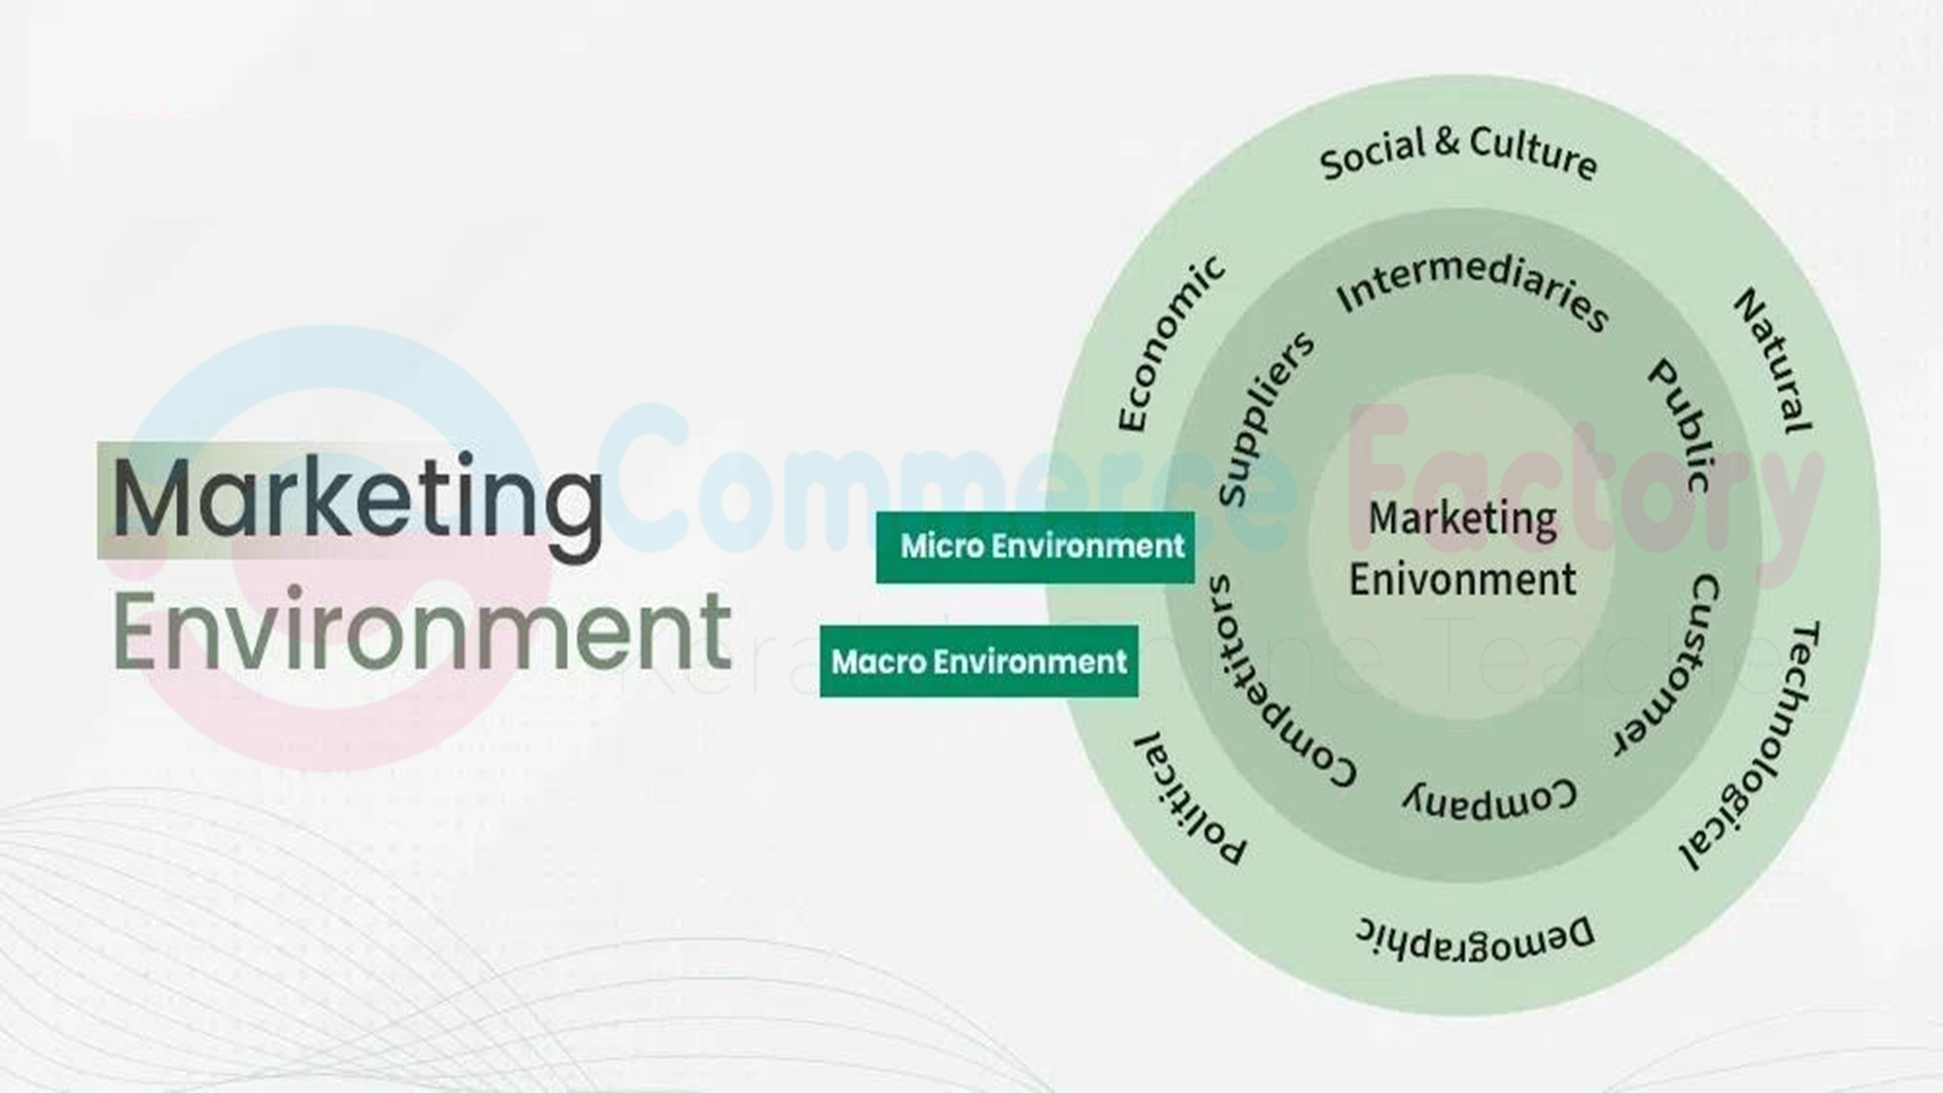

Slide 25
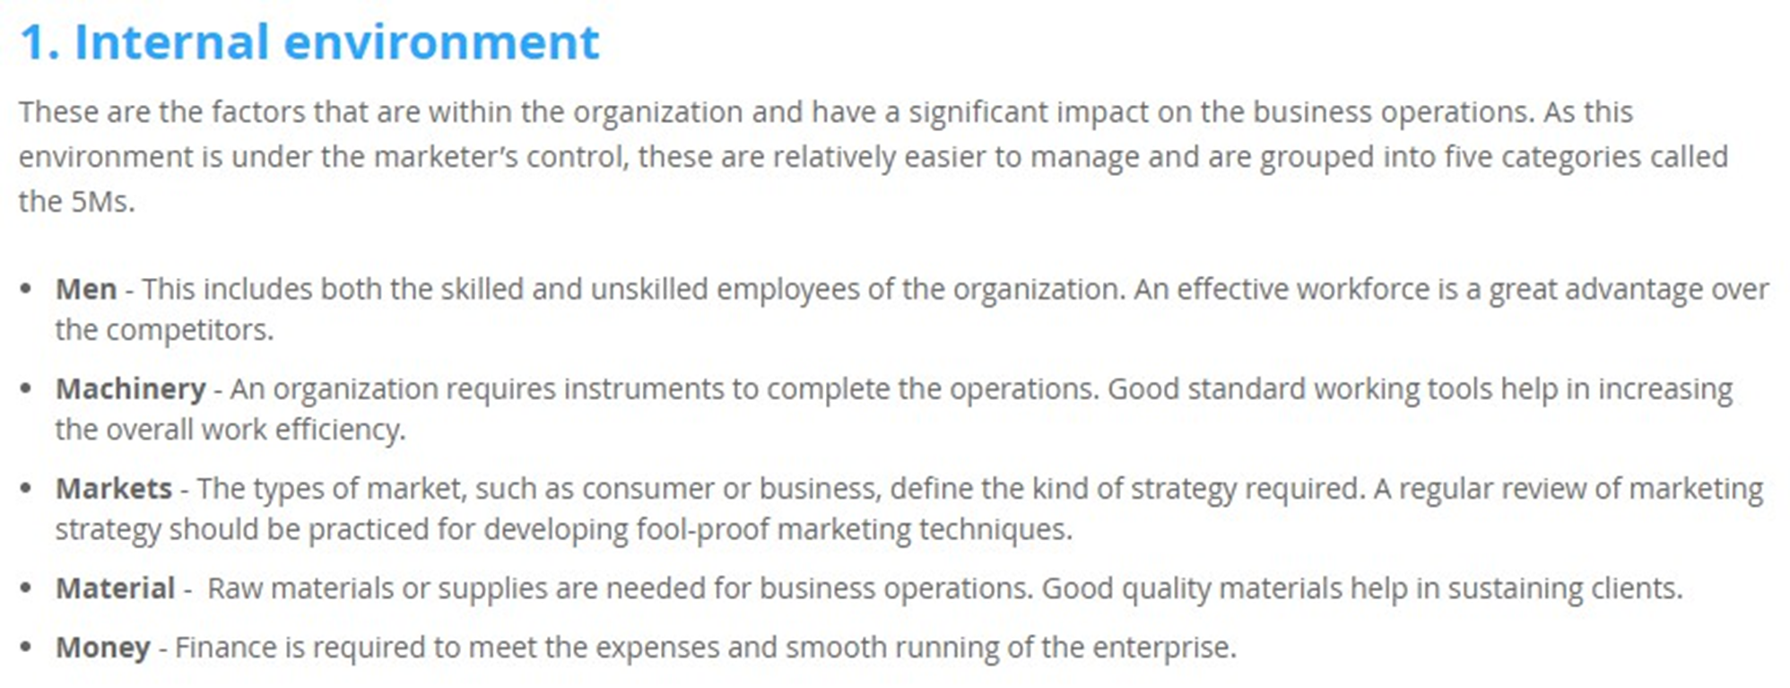

Slide 26
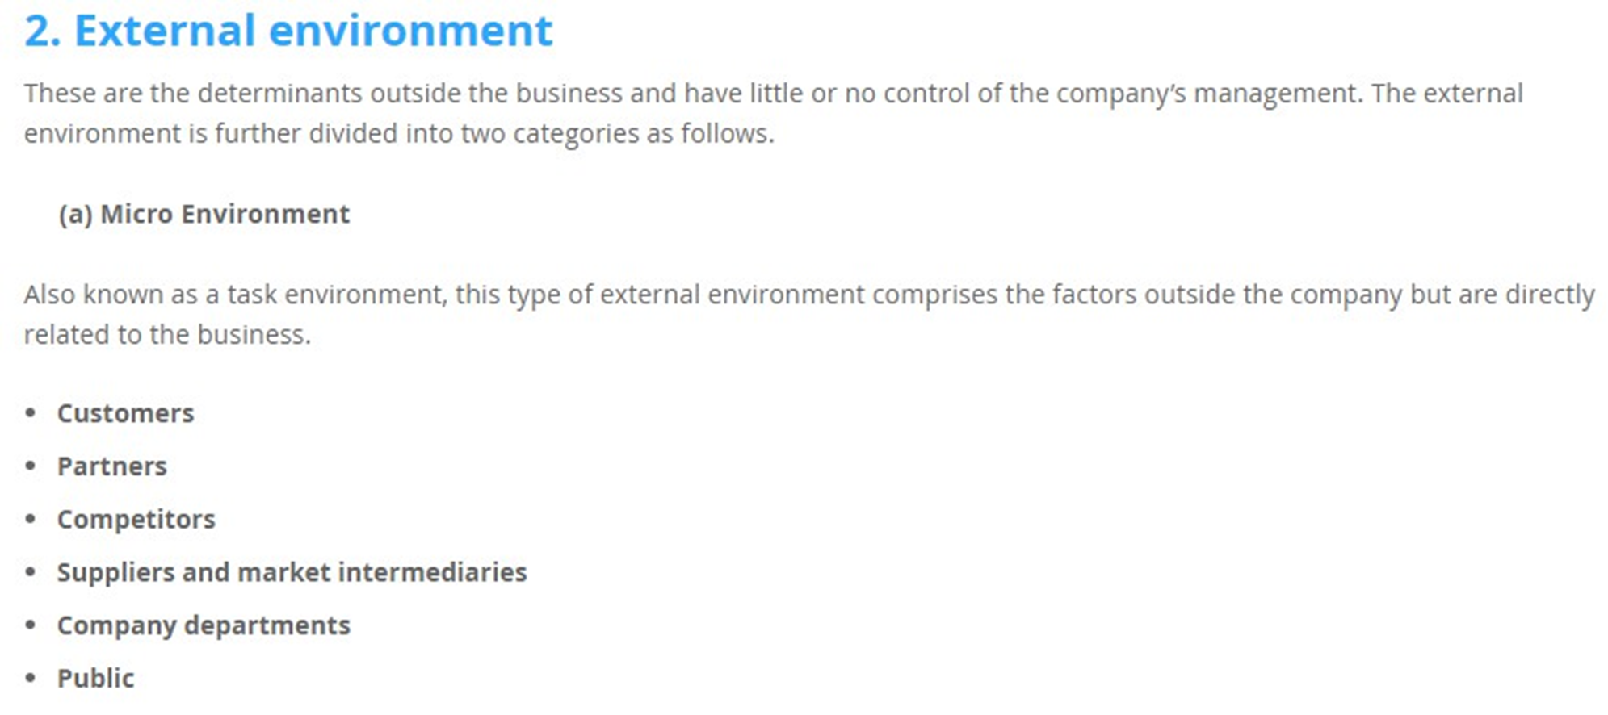

Slide 27
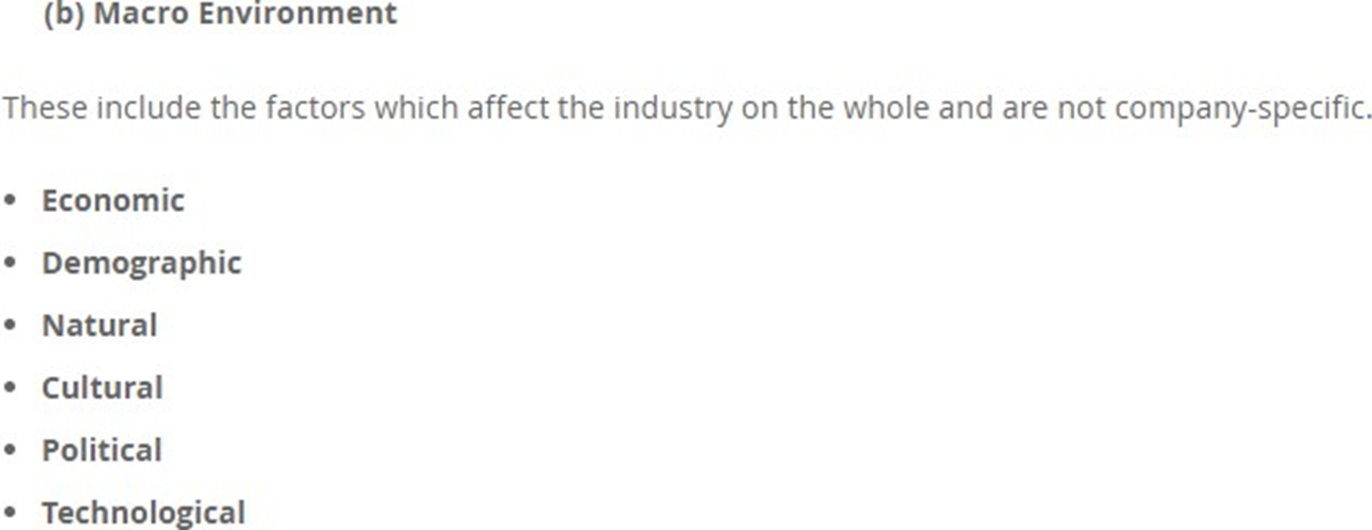

Slide 28
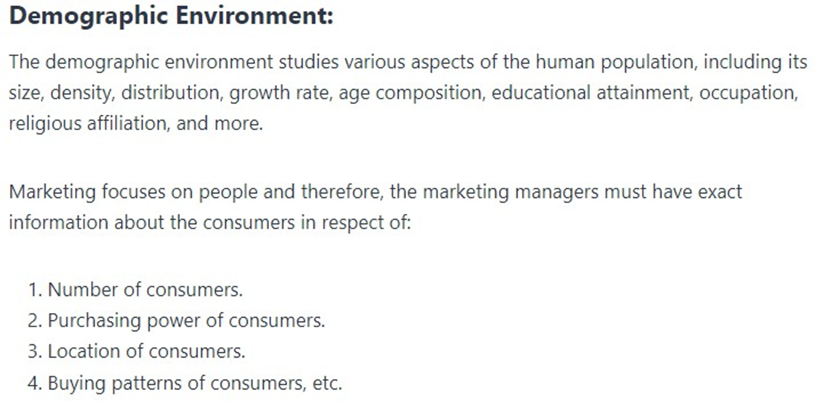

Slide 29
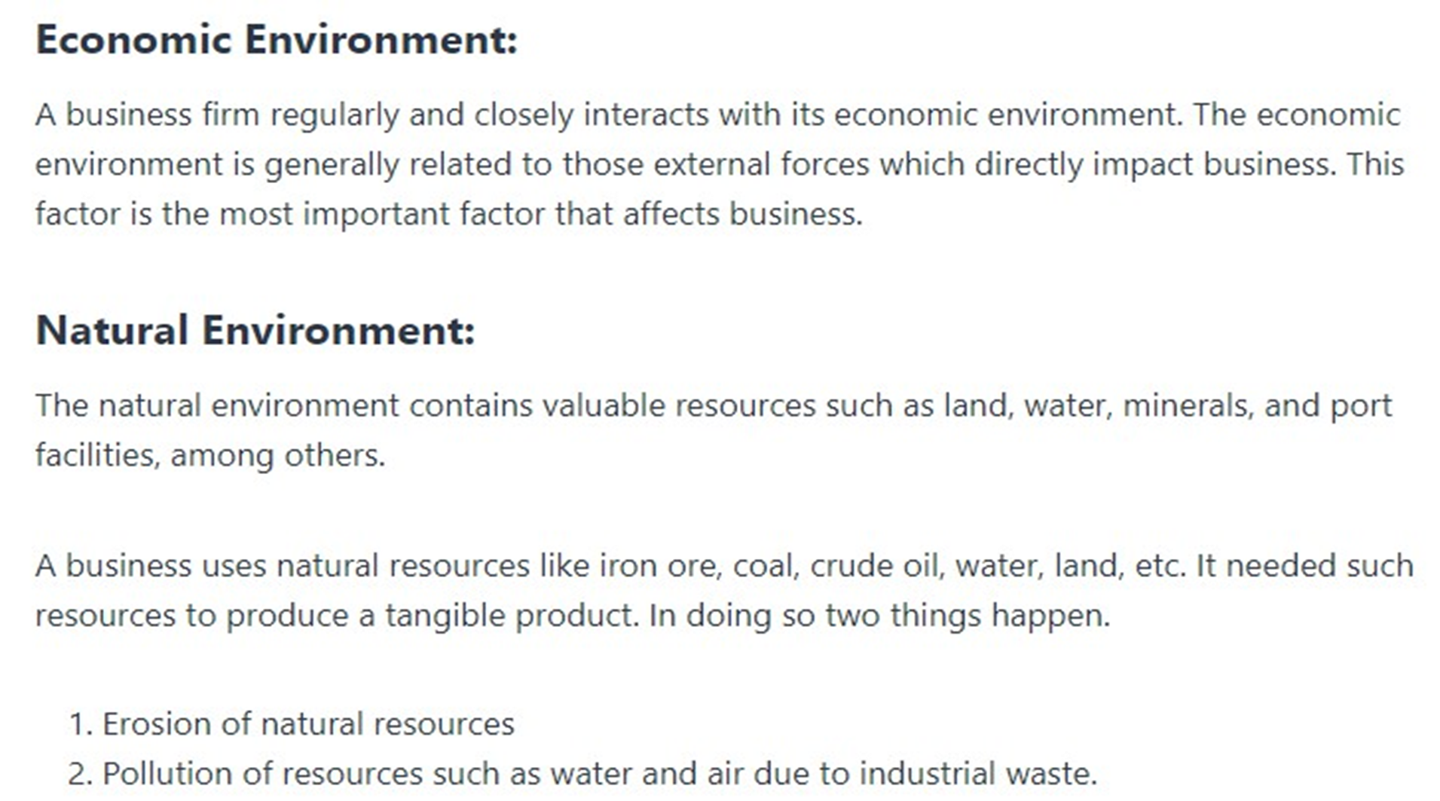

Slide 30
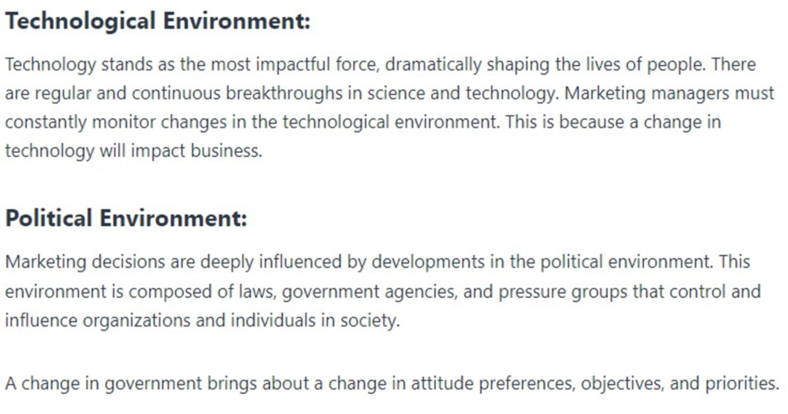

Slide 31
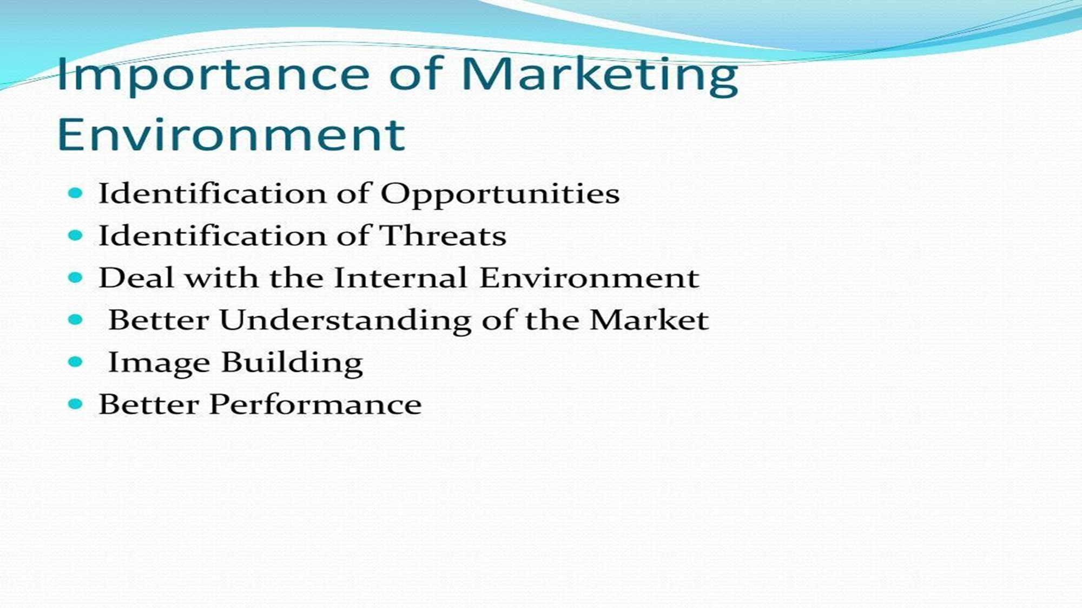

Slide 32
Marketing Mix – The 4Ps of Marketing
1. PRODUCT
Product refers to the goods or services offered to customers.
It includes design, features, quality, and packaging.
A good product should satisfy customer needs and expectations.
Branding helps customers identify the product easily.
Product variety and innovation help attract different types of customers.
Example: A smartphone with good camera quality, latest features, and attractive packaging.

Slide 33
2. PRICE
Price is the amount of money customers pay to buy the product.
It should be affordable and match customer expectations.
Price must be competitive compared to other brands.
Discounts and offers can attract more customers.
Pricing affects sales, profit and brand image.
Example: A budget mobile priced lower to attract students.

Slide 34
3. PLACE
Place refers to how the product reaches the customer.
Includes distribution channels like wholesalers, retailers and online platforms.
Warehousing helps store products safely.
Transportation ensures products reach customers on time.
Availability in the right place increases customer convenience.
Example: Online grocery apps delivering products directly to homes.

Slide 35
4. PROMOTION
Promotion means informing and persuading customers to buy the product.
Includes advertising on TV, social media, newspapers, etc.
Sales promotions like discounts and offers attract buyers.
Personal selling helps explain the product directly to customers.
Publicity creates awareness without direct payment.
Example: A café using Instagram ads to attract young customers.

Slide 36
Role of Marketing
Marketing finds out what customers want.
It makes people interested in buying products.
Marketing helps make a brand popular.
It helps the company sell more and earn money.
Marketing gives ideas for new products.
It helps decide the right price for products.
Marketing keeps customers happy and loyal.
It finds new places or people to sell products.
Marketing tells other departments what customers like.
It tells people about products through ads and promotions.

Slide 37
Example: Coca-Cola
Coca-Cola uses marketing to understand what customers like, such as flavors and packaging. It creates awareness through ads and promotions, helps decide the right price, and ensures drinks are available in stores, restaurants, and vending machines. Marketing also builds a strong brand, keeps customers happy, and guides new ideas like sugar-free or flavored drinks. This way, marketing connects the company with its customers and helps it grow.

Slide 38
Relationship of Marketing with Other Functional Areas

Slide 39
Marketing and Production/Operations
Marketing informs production about customer demand and preferences.
It helps in planning the quantity of products to manufacture.
Marketing provides feedback on product quality and features.
It guides production to design products that meet market expectations.
Marketing helps ensure timely availability of products for customers.

Slide 40
Advantage:
Ensures products are made according to customer demand.
Helps plan production schedules efficiently.
Improves product quality based on customer feedback.
Reduces wastage by aligning production with market needs.
Speeds up introduction of new products.
Disadvantage:
Production may feel pressured to meet marketing deadlines.
Overemphasis on customer demand may compromise operational efficiency.
Conflicts may arise over product features or quantity.
Frequent changes suggested by marketing can disrupt production plans.
Miscommunication can cause delays or errors in output.

Slide 41
2. Marketing and Finance
Marketing helps in setting profitable and competitive prices.
Sales forecasts from marketing aid financial planning and budgeting.
It helps decide the allocation of funds for promotions and campaigns.
Marketing evaluates the return on investment (ROI) of advertising efforts.
It assists in planning strategies to maximize revenue and profits.

Slide 42
Advantages:
Helps in setting profitable and competitive prices.
Provides accurate sales forecasts for budgeting.
Guides allocation of funds for promotions and campaigns.
Evaluates return on investment for marketing activities.
Supports financial planning for growth strategies.
Disadvantages:
Finance may over-rely on marketing forecasts.
Conflicts over budget allocation can arise.
Short-term marketing campaigns may clash with long-term financial planning.
Marketing may push expensive campaigns that strain budgets.
Differences in priorities can delay financial decisions.

Slide 43
3.Marketing and Human Resources (HR)
HR recruits and trains staff for marketing and customer service roles.
Marketing communicates skill requirements to HR for effective staffing.
HR organizes training programs based on marketing strategies and campaigns.
Marketing feedback helps HR improve employee performance and motivation.
Collaboration ensures smooth teamwork between marketing and other departments.

Slide 44
Advantages:
HR recruits and trains staff for marketing and sales functions.
Ensures employees have skills needed for campaigns.
Promotes better teamwork between marketing and other departments.
Training programs align with marketing strategies.
Improves employee performance and motivation.
Disadvantages:
HR may face pressure to hire quickly for marketing campaigns.
Overlap in responsibilities may cause confusion.
Conflicts if marketing demands skills HR cannot immediately provide.
Coordination can be time-consuming.
Marketing-focused training may neglect other department needs.

Slide 45
Marketing and Research & Development (R&D)
Marketing provides customer insights for new product development.
It helps R&D design products that meet customer expectations.
Marketing feedback ensures product innovation aligns with market trends.
It communicates competitor product features to R&D for improvement.
Collaboration reduces the risk of product failure in the market.

Slide 46
Advantages:
Provides insights into customer needs for new product development.
Helps design products that meet market expectations.
Reduces risk of product failure through market feedback.
Keeps R&D updated on competitor trends.
Supports innovation aligned with customer demand.
Disadvantages:
Marketing pressure may push for rushed product development.
R&D may feel constrained by marketing suggestions.
Conflicts over feasibility vs. customer demand may arise.
Overemphasis on trends can limit long-term innovation.
Miscommunication may result in products not meeting expectations.

Slide 47
Marketing and Supply Chain/Logistics
Marketing shares demand forecasts to help manage inventory efficiently.
It coordinates product availability at stores and distribution points.
Marketing informs logistics about seasonal or promotional demands.
Collaboration ensures timely delivery of products to customers.
It helps reduce shortages or overstock by predicting market needs.

Slide 48
Advantages:
Helps manage inventory efficiently based on demand forecasts.
Ensures products are delivered on time.
Supports planning for seasonal or promotional demands.
Reduces stockouts or overstock situations.
Improves overall customer satisfaction.
Disadvantages:
Logistics may struggle to meet sudden marketing demands.
Conflicts may arise over delivery schedules.
Over-reliance on marketing forecasts can create inefficiencies.
Frequent changes in marketing plans can disrupt supply chain.
Miscommunication can cause delays or increased costs.

Slide 49
Marketing Approaches

Slide 50
1.Production-Oriented Approach
Focuses on producing goods in large quantities.
Emphasizes low production costs and efficiency.
Assumes customers will buy products that are widely available.
Less attention is given to customer preferences.
Works well when demand exceeds supply.
Prioritizes mass production over customization.
Often uses standardized products.
Example: Early Ford Motor Company mass-producing the Model T car.

Slide 51
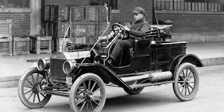
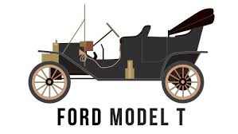
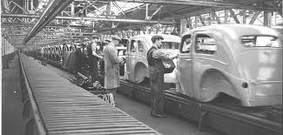
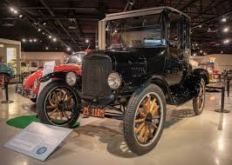

Slide 52
2.Product-Oriented Approach
Focuses on product quality, performance, and innovation.
Believes customers prefer high-quality products.
Invests in research and development for better products.
May neglect marketing and customer feedback.
Suitable for technical or luxury products.
Encourages continuous product improvement.
Focuses on features, design, and durability.
Example: Apple creating innovative and high-quality devices like iPhones and MacBooks.

Slide 53


Slide 54
3. Sales-Oriented Approach
Focuses on selling products aggressively.
Uses promotions, discounts, and advertising to boost sales.
Assumes customers won’t buy without persuasion.
Works well when there is overproduction or competition.
Prioritizes short-term sales over customer needs.
Sales techniques may include personal selling and telemarketing.
Often ignores long-term customer relationships.
Example: Insurance companies using agents to push policies.

Slide 55


Slide 56
4. Marketing-Oriented Approach
Focuses on identifying and satisfying customer needs.
Uses market research to understand customer preferences.
Targets specific market segments.
Develops products based on customer demand.
Builds long-term customer relationships.
Uses promotions to inform and attract the right audience.
Balances quality, price, place, and promotion (4Ps).
Example: Coca-Cola developing drinks according to local taste preferences.

Slide 57
5. Societal Marketing Approach
Focuses on customer satisfaction and social responsibility.
Considers environmental and ethical concerns.
Encourages sustainable and eco-friendly products.
Balances company profit, customer wants, and societal well-being.
Builds a positive brand image through social responsibility.
Educates customers about sustainable choices.
Supports long-term customer loyalty.
Example: Patanjali promoting natural, eco-friendly, and health-conscious products.

Slide 58
